Slide 1
“European Heritage: Opening minds for Integration and progress”
2018-2020
Survey about
Inclusion in our society
by
Liceo Scientifico Europeo ‘Mario Pagano’
9-14 September 2019, Campobasso – Italy

Slide 2
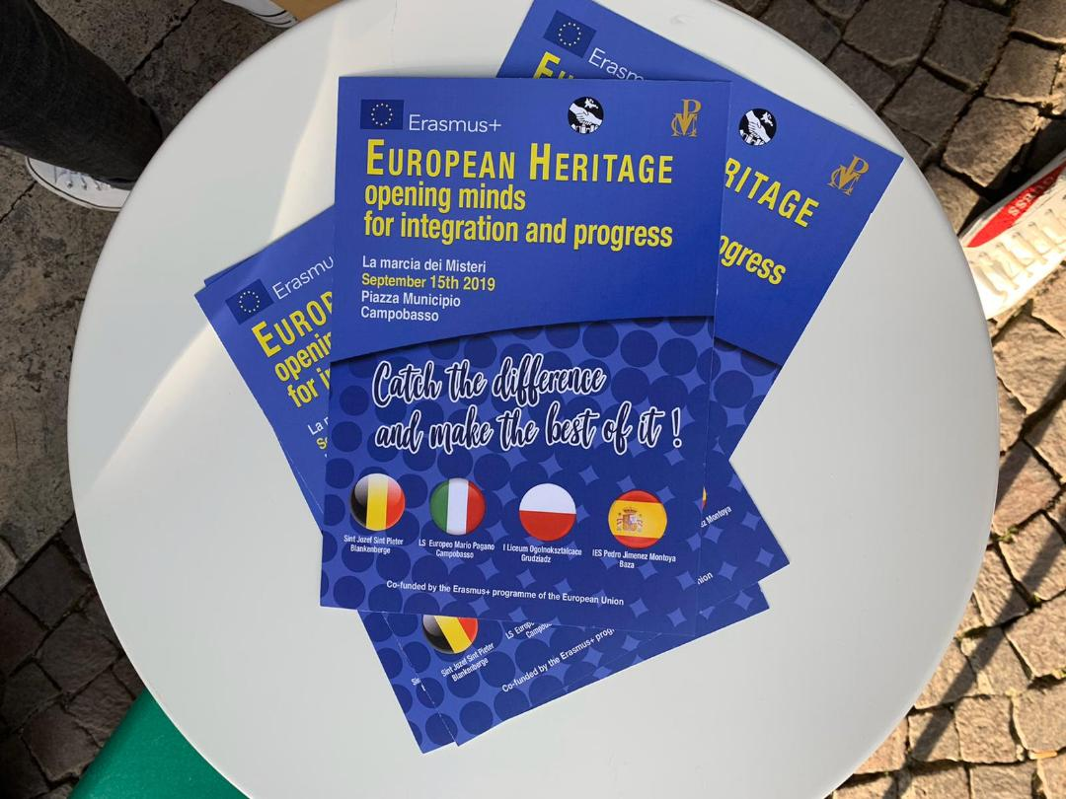
A I M o f T H E S U R V E Y
To make people aware of the Inclusion Issue

Slide 3
F I R S T S T E P
1. ORGANIZATION OF THE AWARENESS CAMPAIGN
2. PROMOTION OF THE AWARENESS CAMPAIGN THROUGH MEDIA AND SOCIAL MEDIA
3. PREPARATION OF THE QUESTIONNAIRE TO DISTRIBUTE DURING THE LOCAL EVENT “LA MARCIA DEI MISTERI – THE MYSTERIES FOOT RACE”

Slide 4
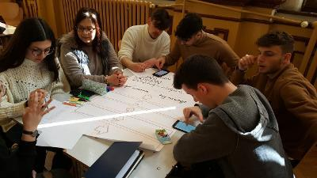
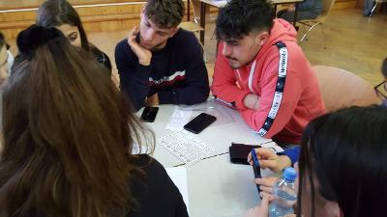
1. ORGANIZATION OF THE AWARENESS CAMPAIGN

Slide 5
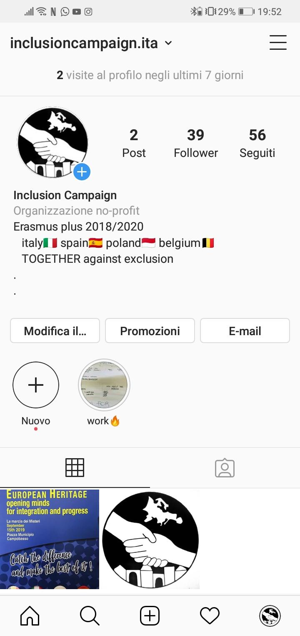
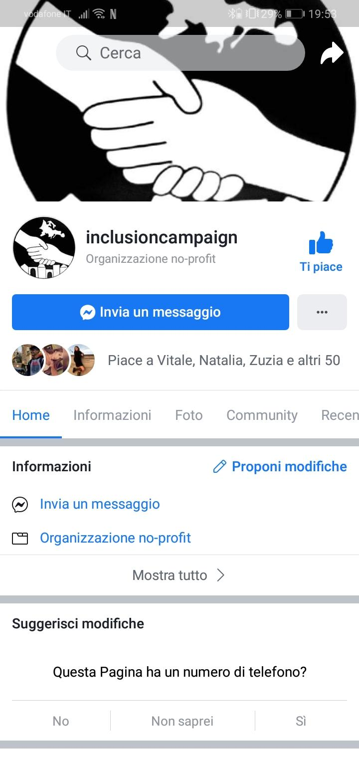
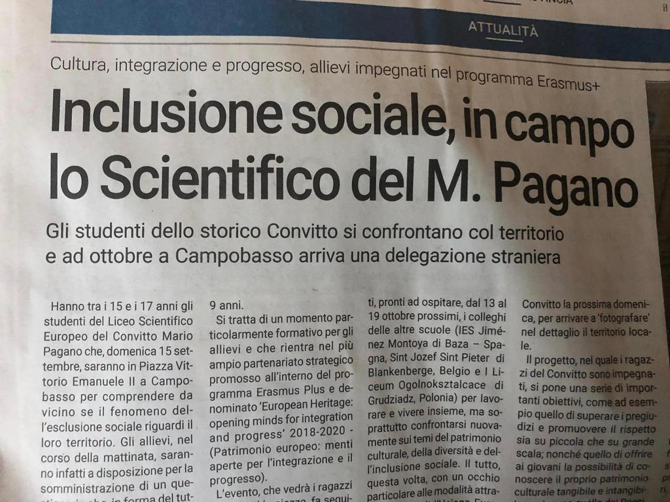
2. PROMOTION OF THE AWARENESS CAMPAIGN THROUGH MEDIA AND SOCIAL MEDIA

Slide 6
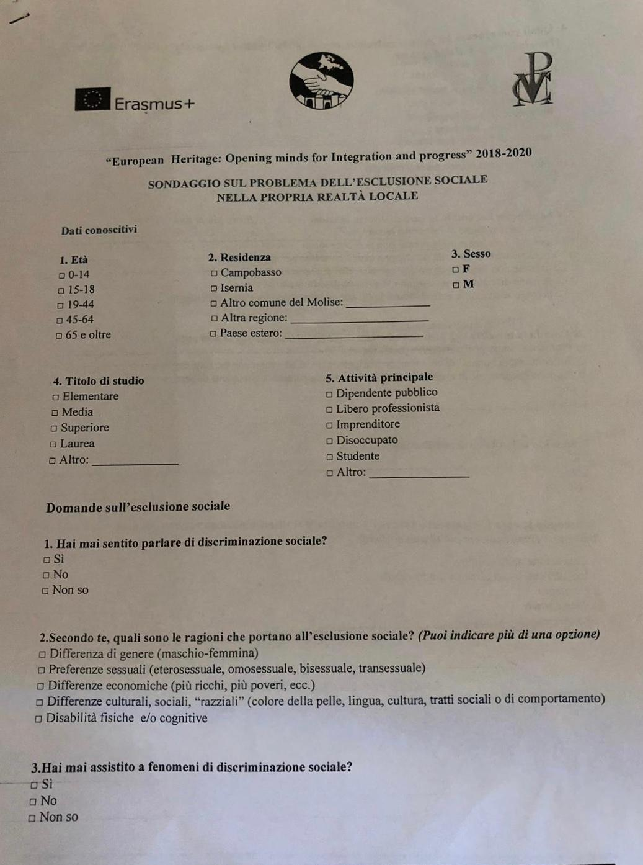
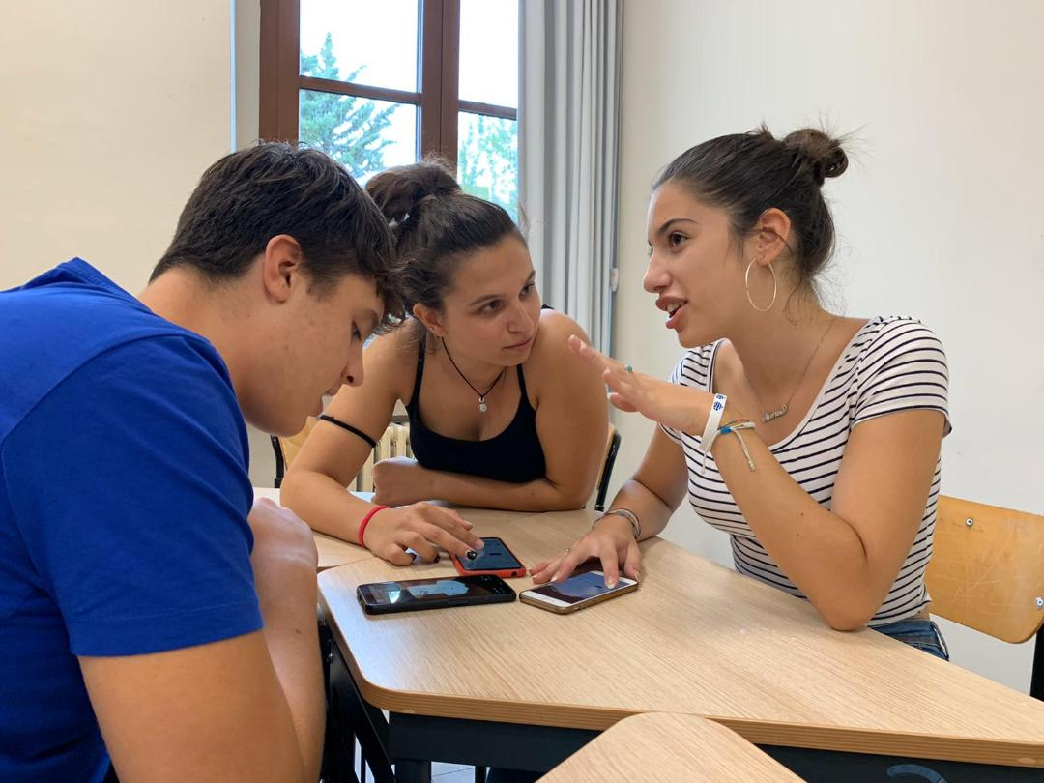
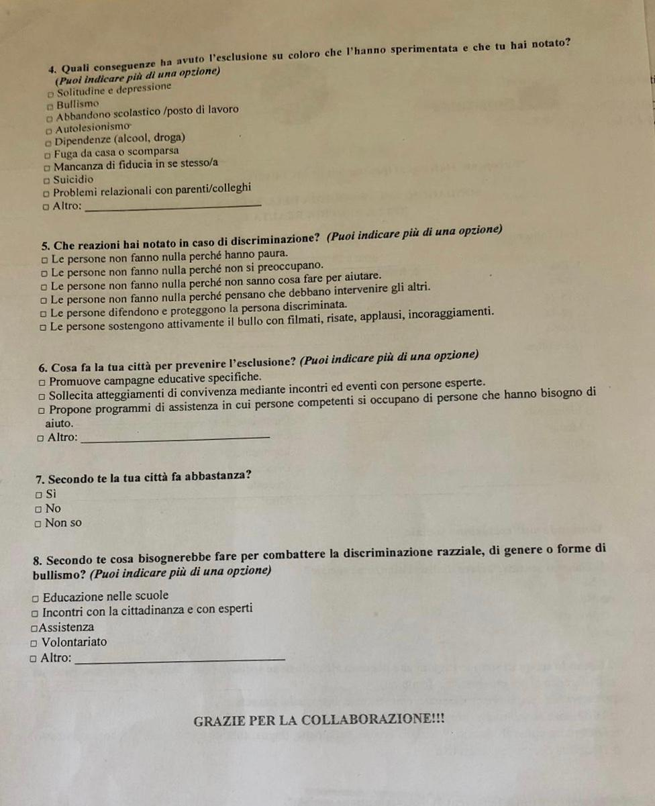
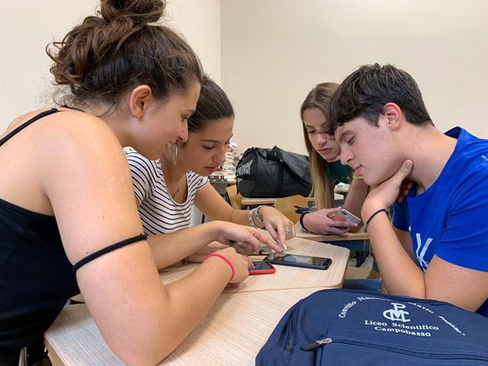
3. PREPARATION OF THE QUESTIONNAIRE TO DISTRIBUTE DURING THE LOCAL EVENT “LA MARCIA DEI MISTERI – THE MYSTERIES FOOTRACE”

Slide 7
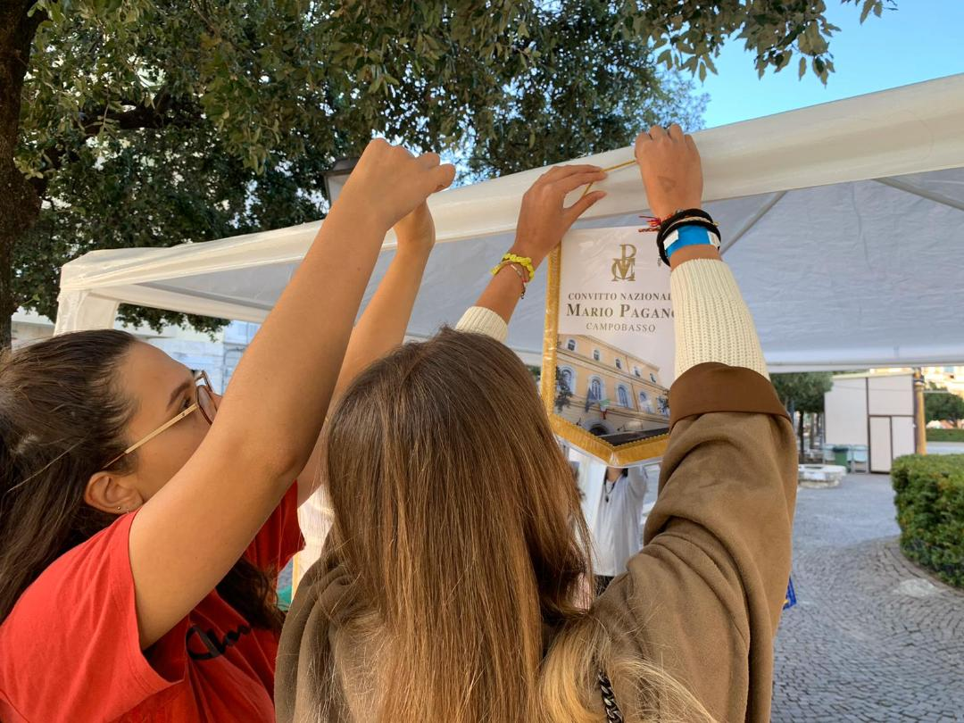
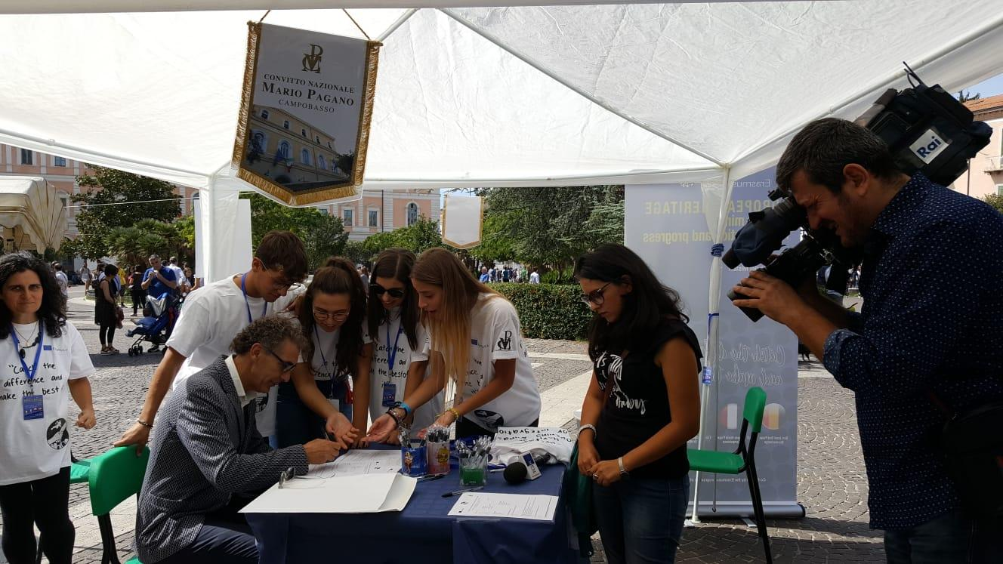
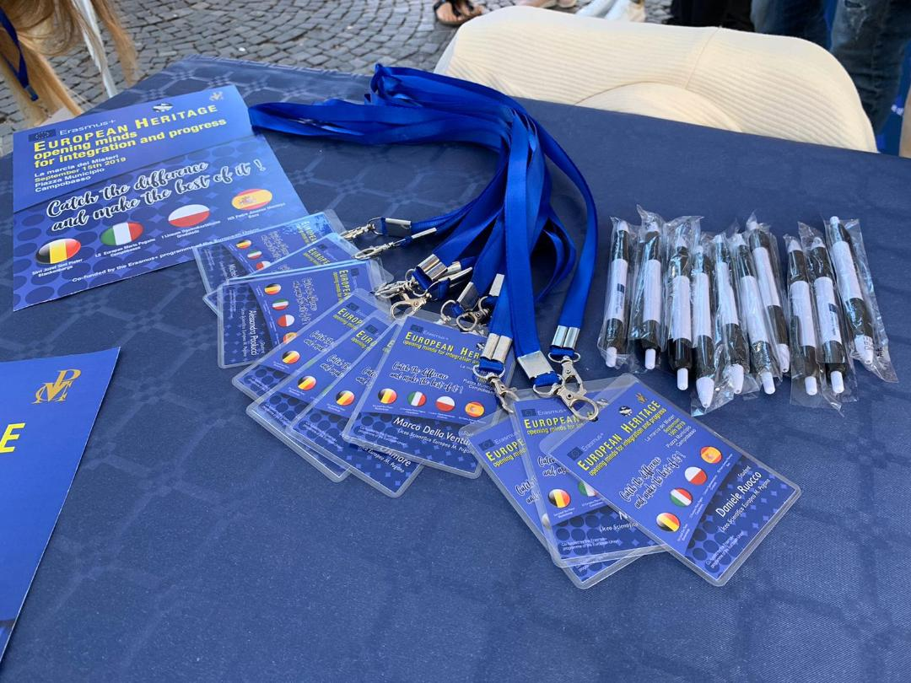
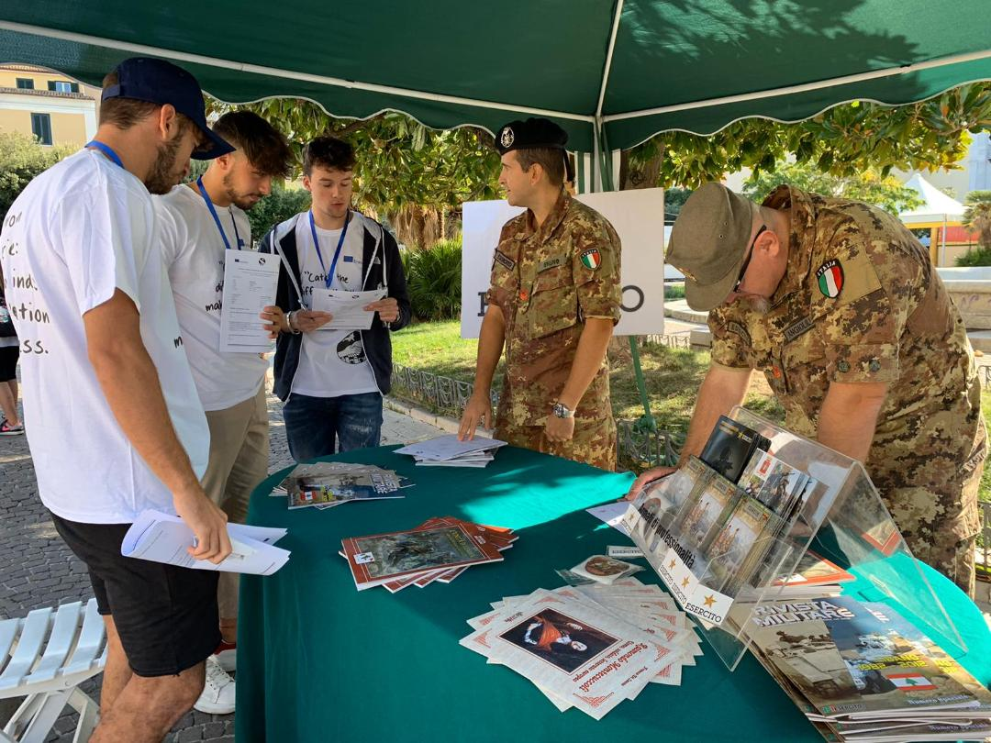
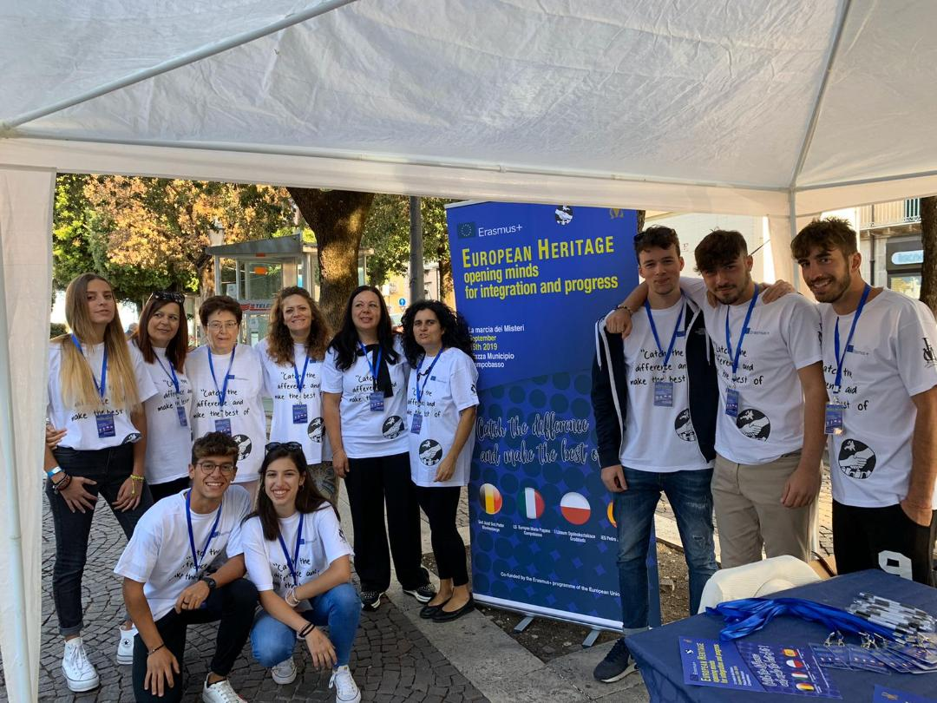
S E C O N D S T E P
HANDING OUT THE QUESTIONNAIRE

Slide 8
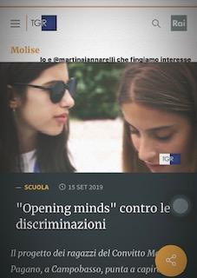
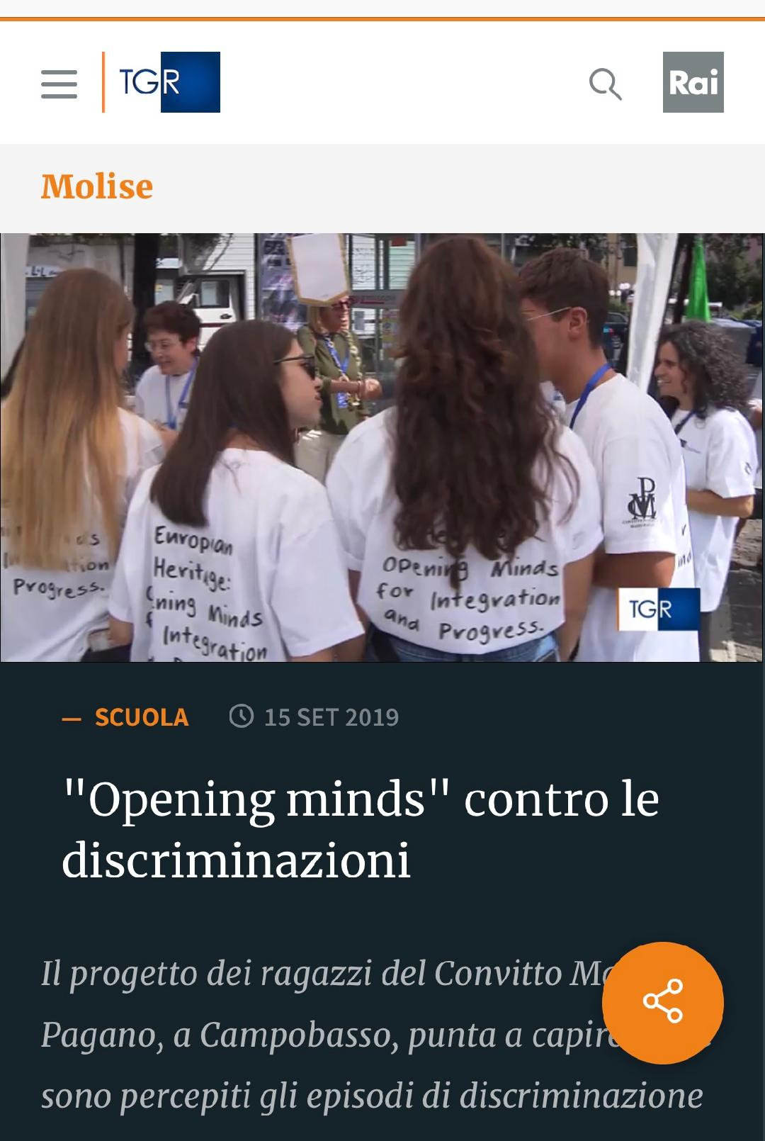
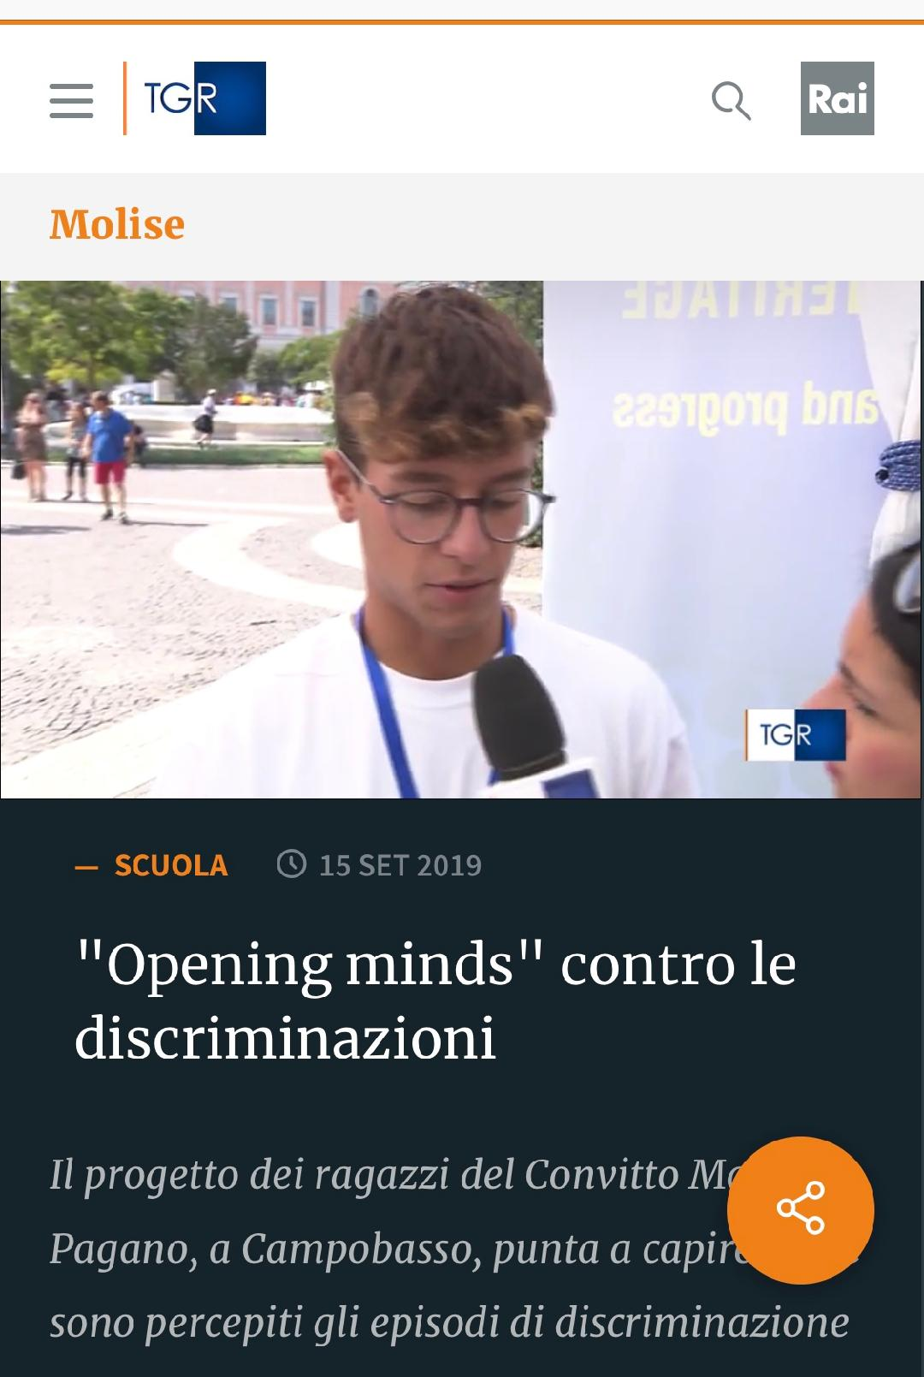
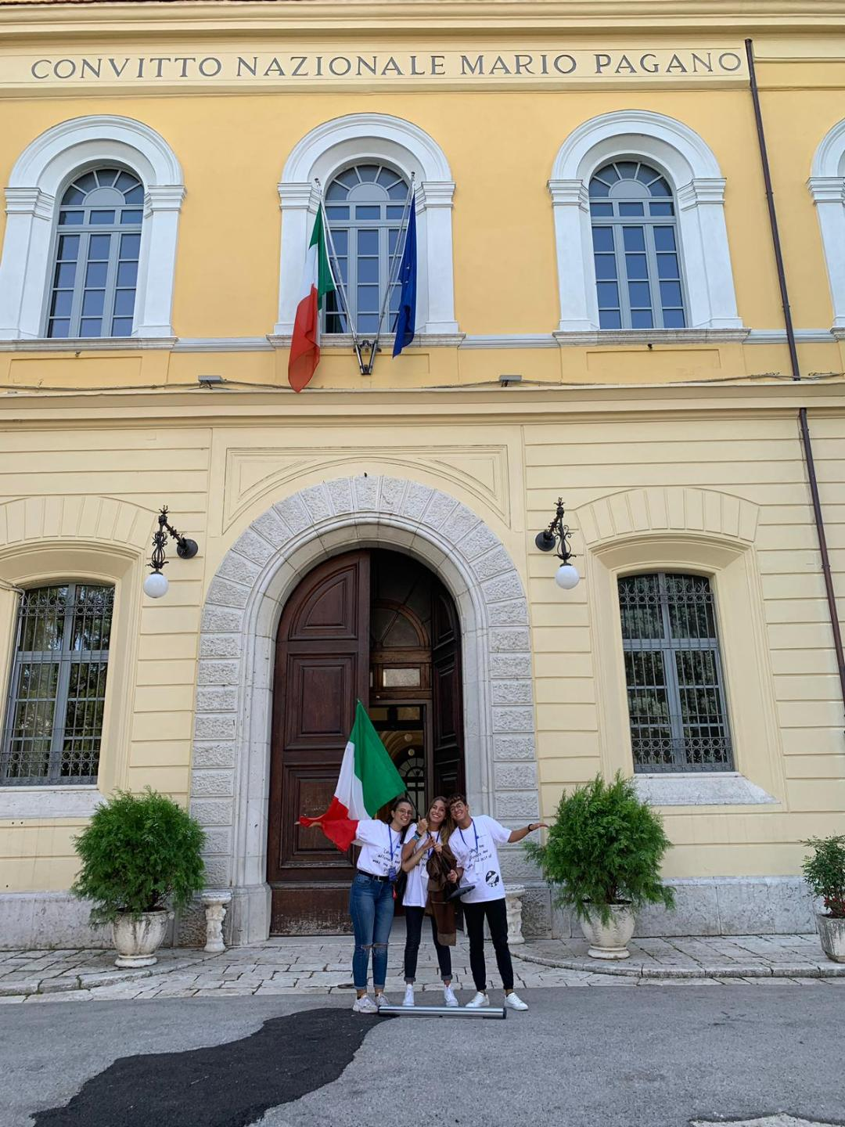
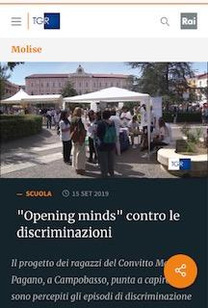
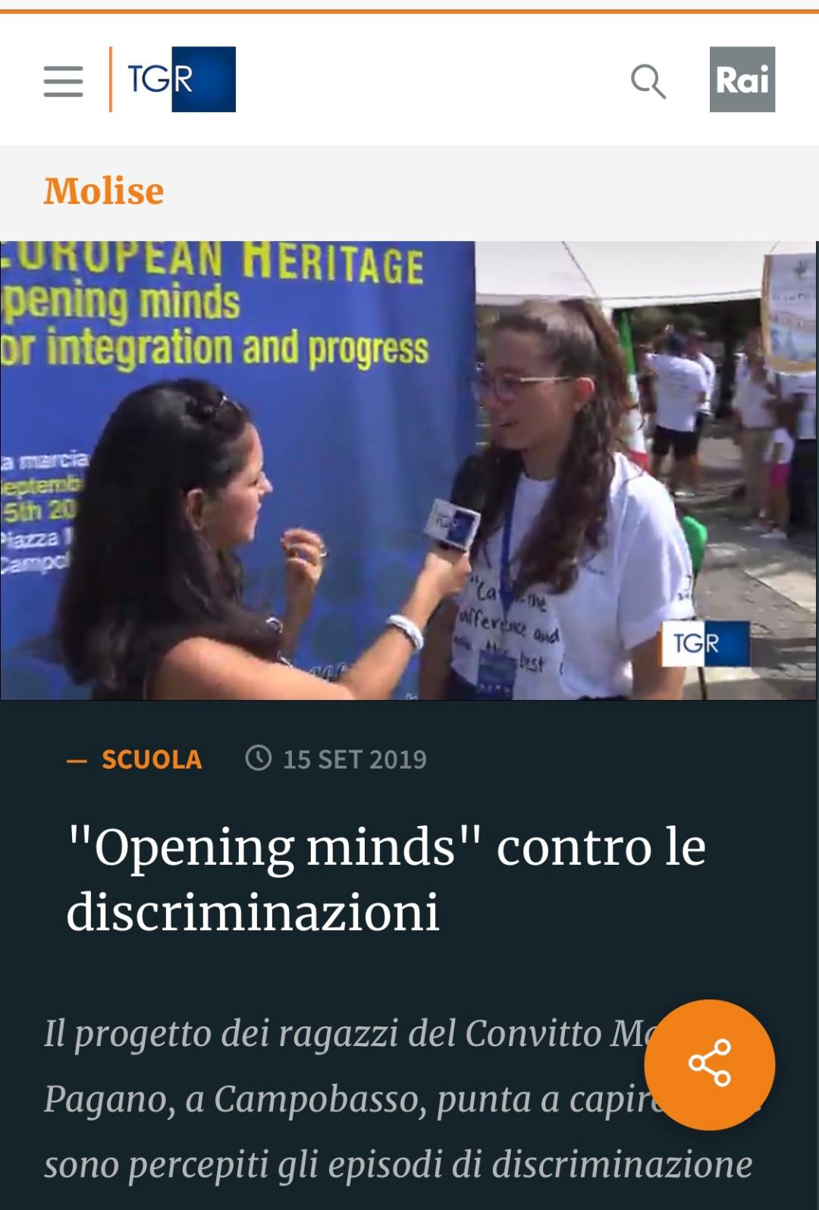
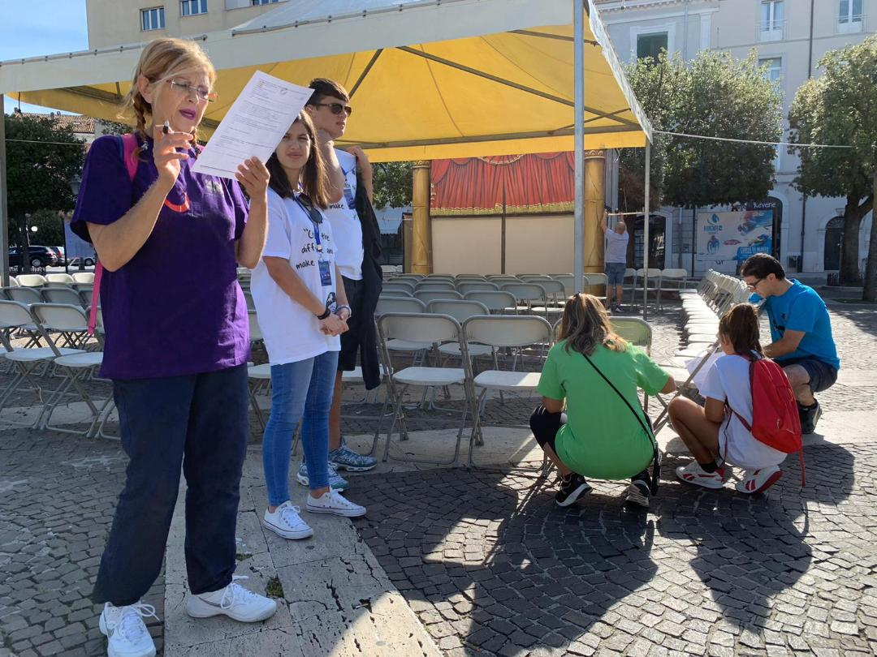

Slide 9
SURVEY RESULTS
T H I R D S T E P
SURVEY CROSS-SECTION
Number of people interviewed | 200
Age | 8 - over 65 years
Sex | M: 55% F: 42% (No answer: 3%)
Residence | Molise Region : 92%
Qualification | Diploma di scuola superiore: 51,5%
Occupation | Student: 33,5%; Public employee: 26,5%

Slide 10
T H I R D S T E P
SOME ANSWERS OF THE SURVEY
ON THE MAIN ASPECTS OF
SOCIAL INCLUSION

Slide 11
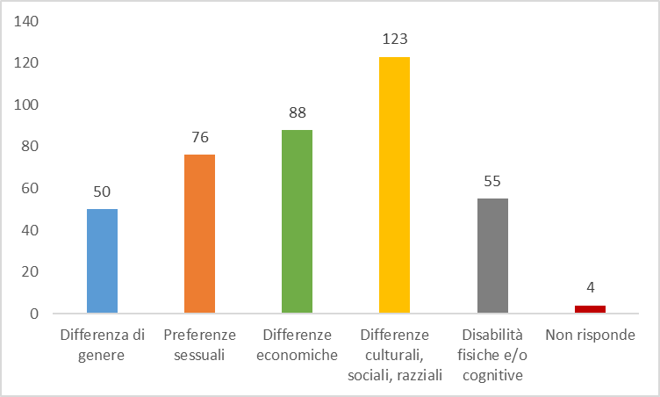
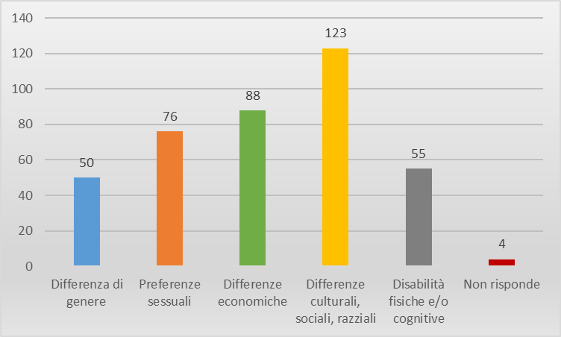
. 1. In your opinion, what are the major causes of social exclusion? (You can give more than one answer)
ReasonS of exclusion
Most people (123, that is 61,5%) think that the major reasons for social exclusion are social, cultural and racial differences.

Slide 12
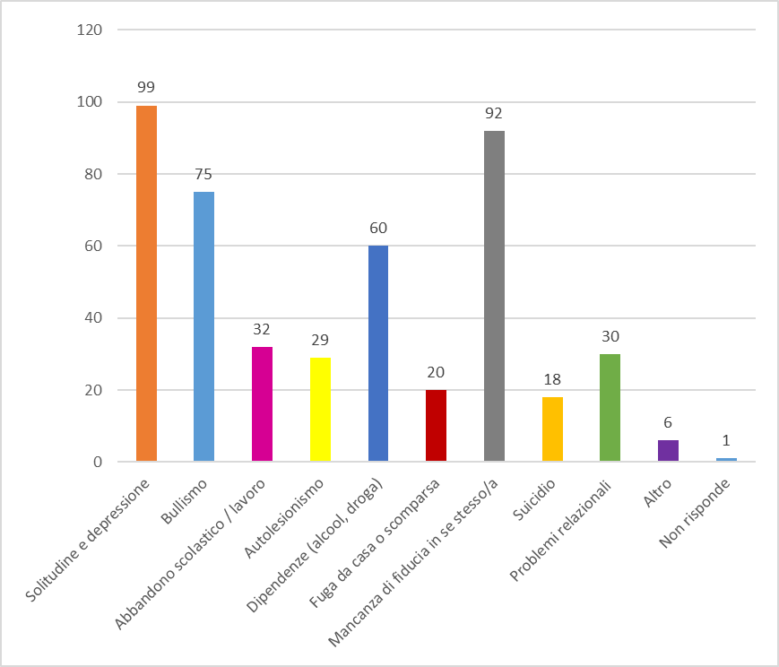
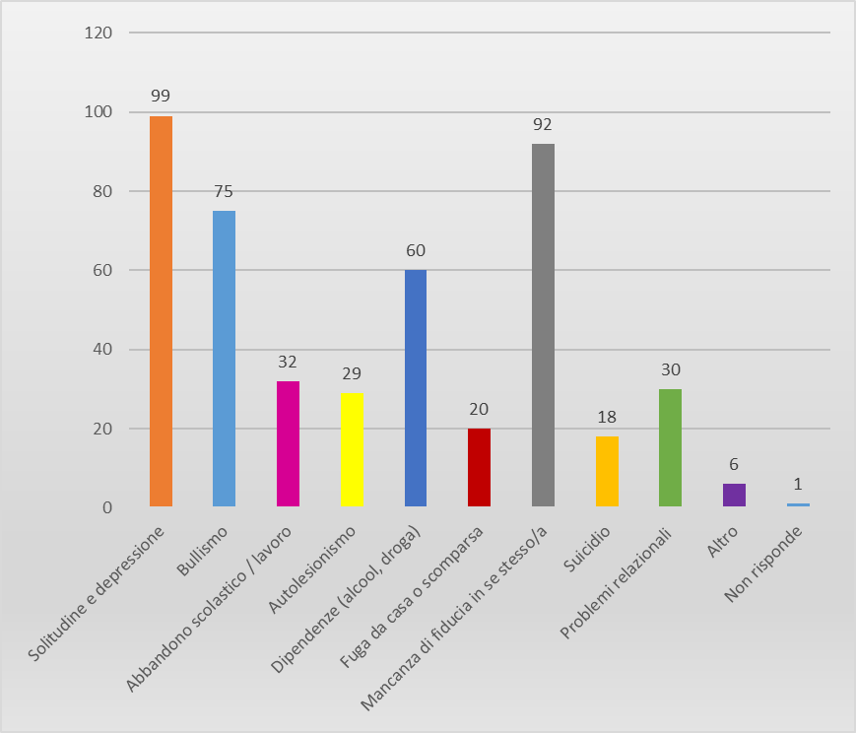
After asking “Have you ever witnessed a discriminating action? We asked the following question: 2. What consequences did exclusion have on those that suffered it and that you witnessed ? (You can choose more than one option)
Consequences of exclusion
ExPERIENCES
Loneliness and depression (99 people)
Lack of self-esteem (92 people)
Bullying (75 people)

Slide 13
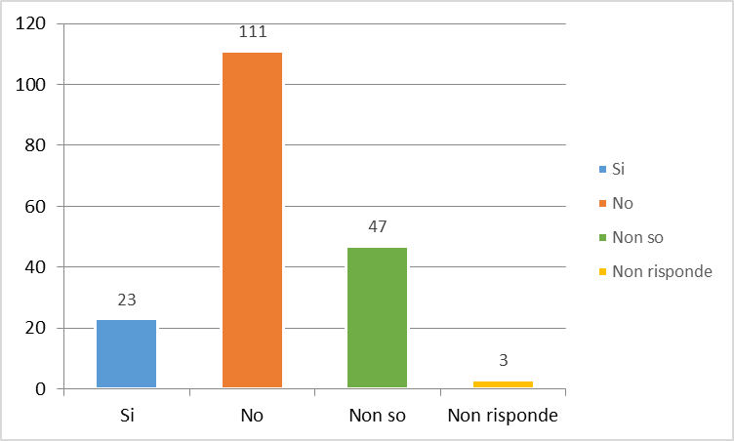
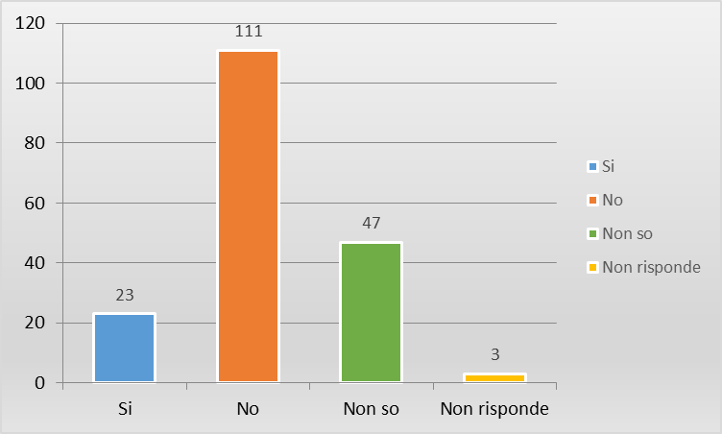
3. In your opinion, does your city do enough to promote social inclusion?
Promotion of inclusion
111 people out of the 184 living in our Region, think that our city doesn’t do enough
To prevent social discrimination and therefore to promote social inclusion.

Slide 14
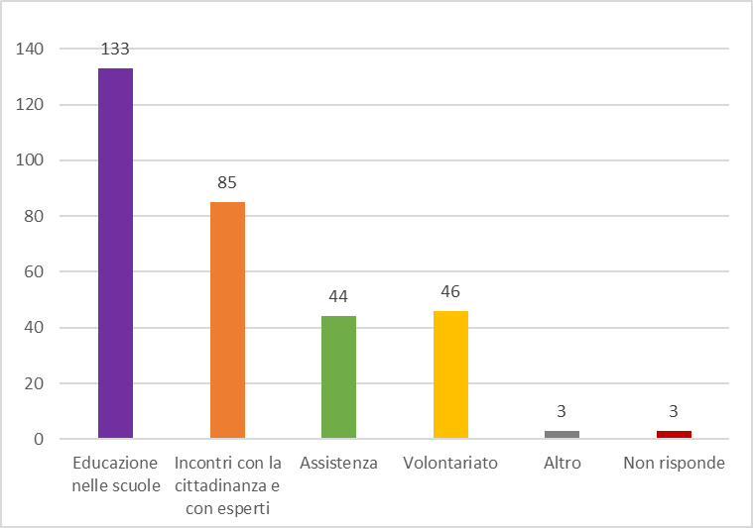
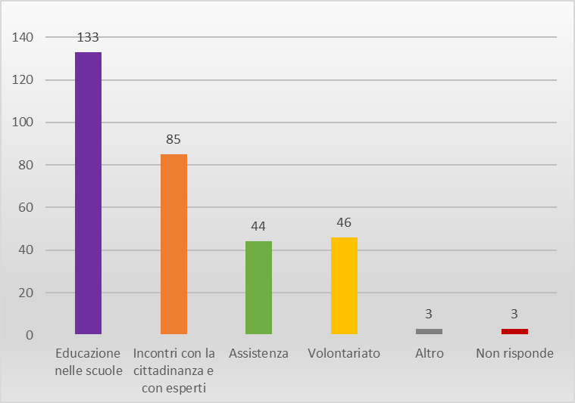
4. In your opinion, what should be done to fight against racial, gender discrimination and against any forms of bullying? (You can choose more than one option)
Proposals
Of inclusion
Education at school (133 people)
Meeting citizens and experts (85 people)
Volunteering (46 people).

Slide 15
What is our region doing????
INTERVIEW WITH OUR REGIONAL COUNCILOR MEMBER
PAOLA MATTEO

Slide 16
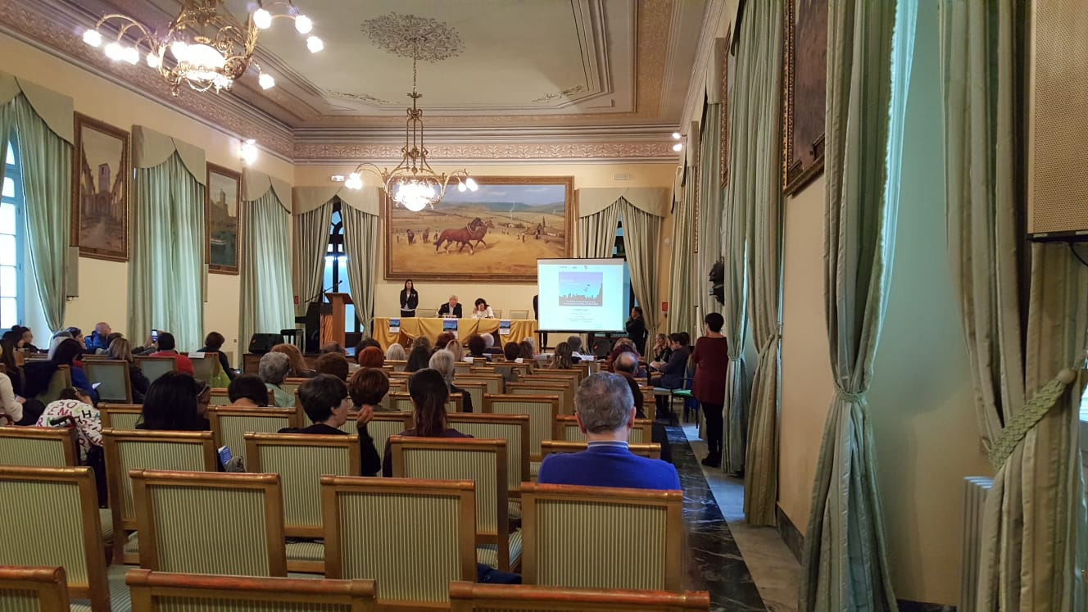
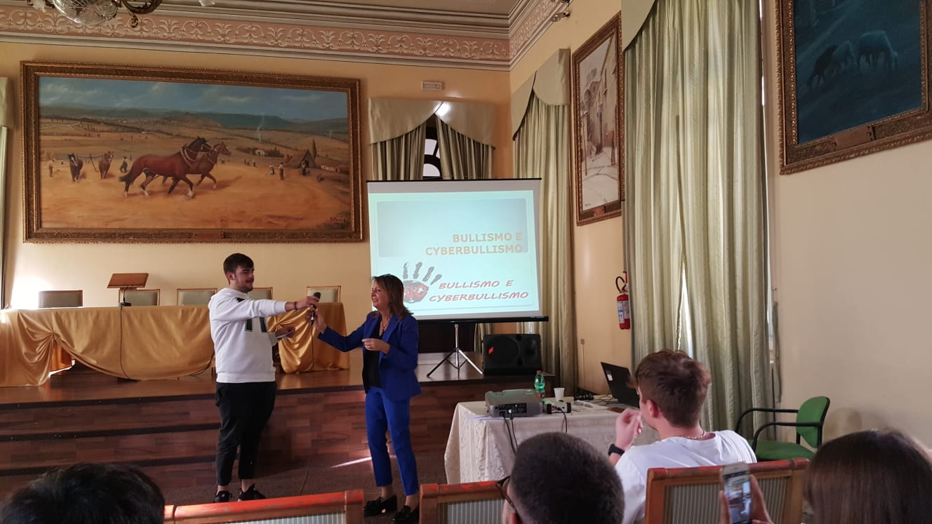
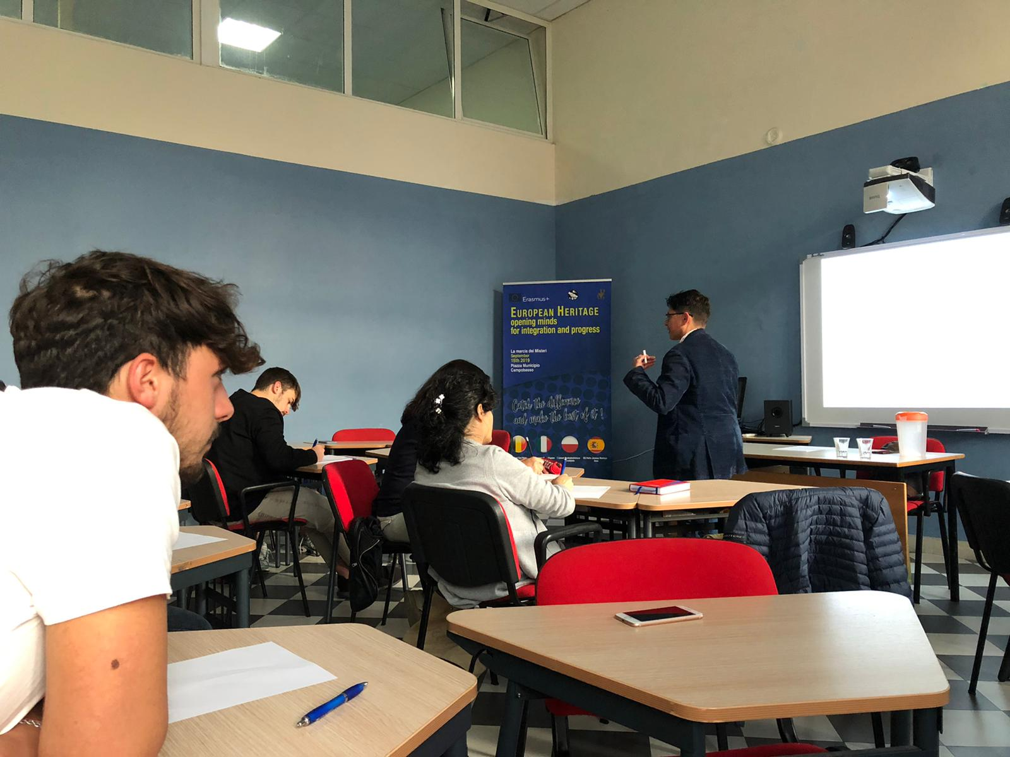
Further activities to foster inclusion
Mrs
C. Adamo
Examples of good social practices
Workshop on bullying and cyberbullying
Professor F. Monceri
from Unimol
Didactic approaches to overcome exclusion

Slide 17
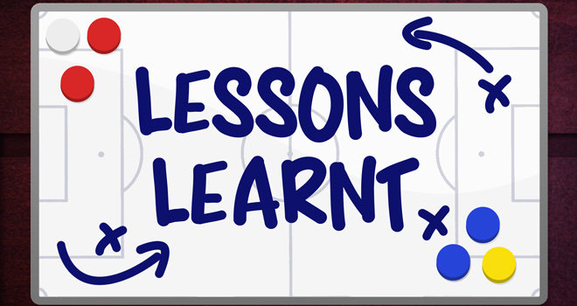
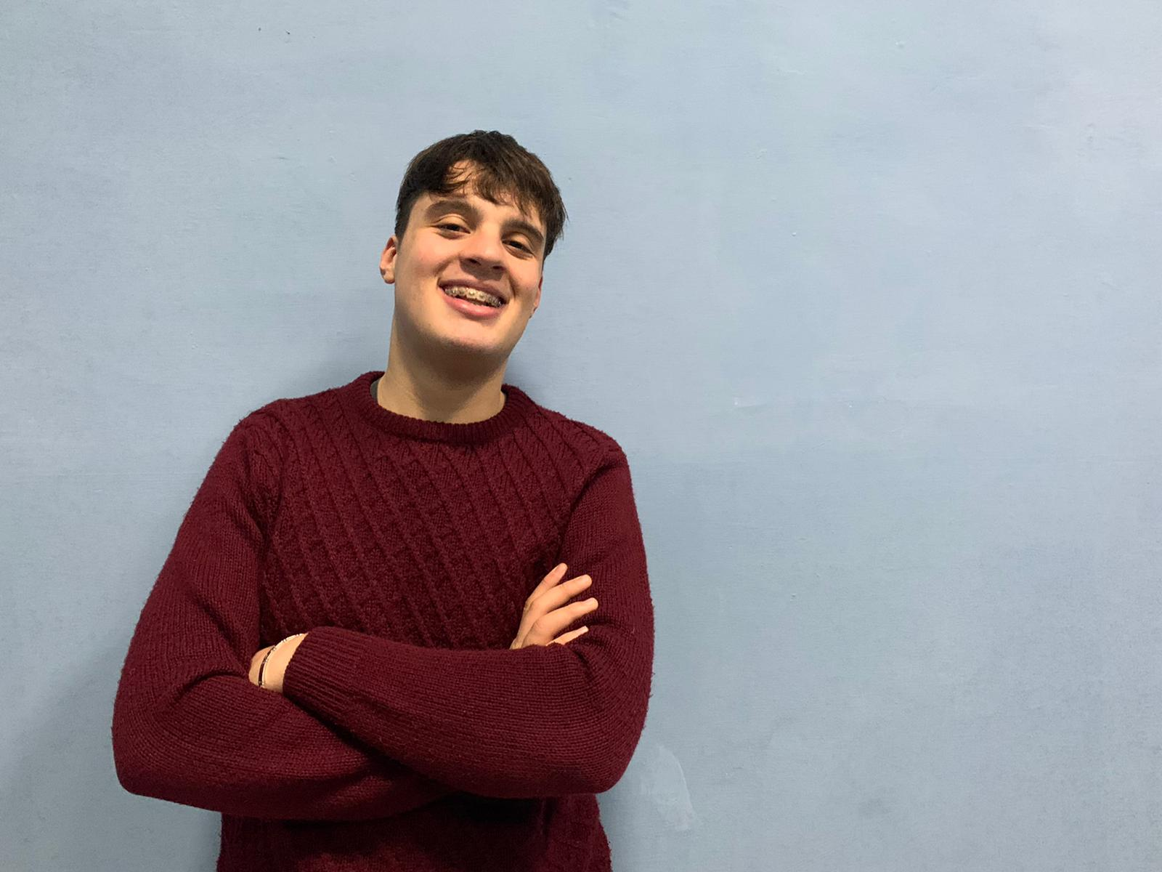
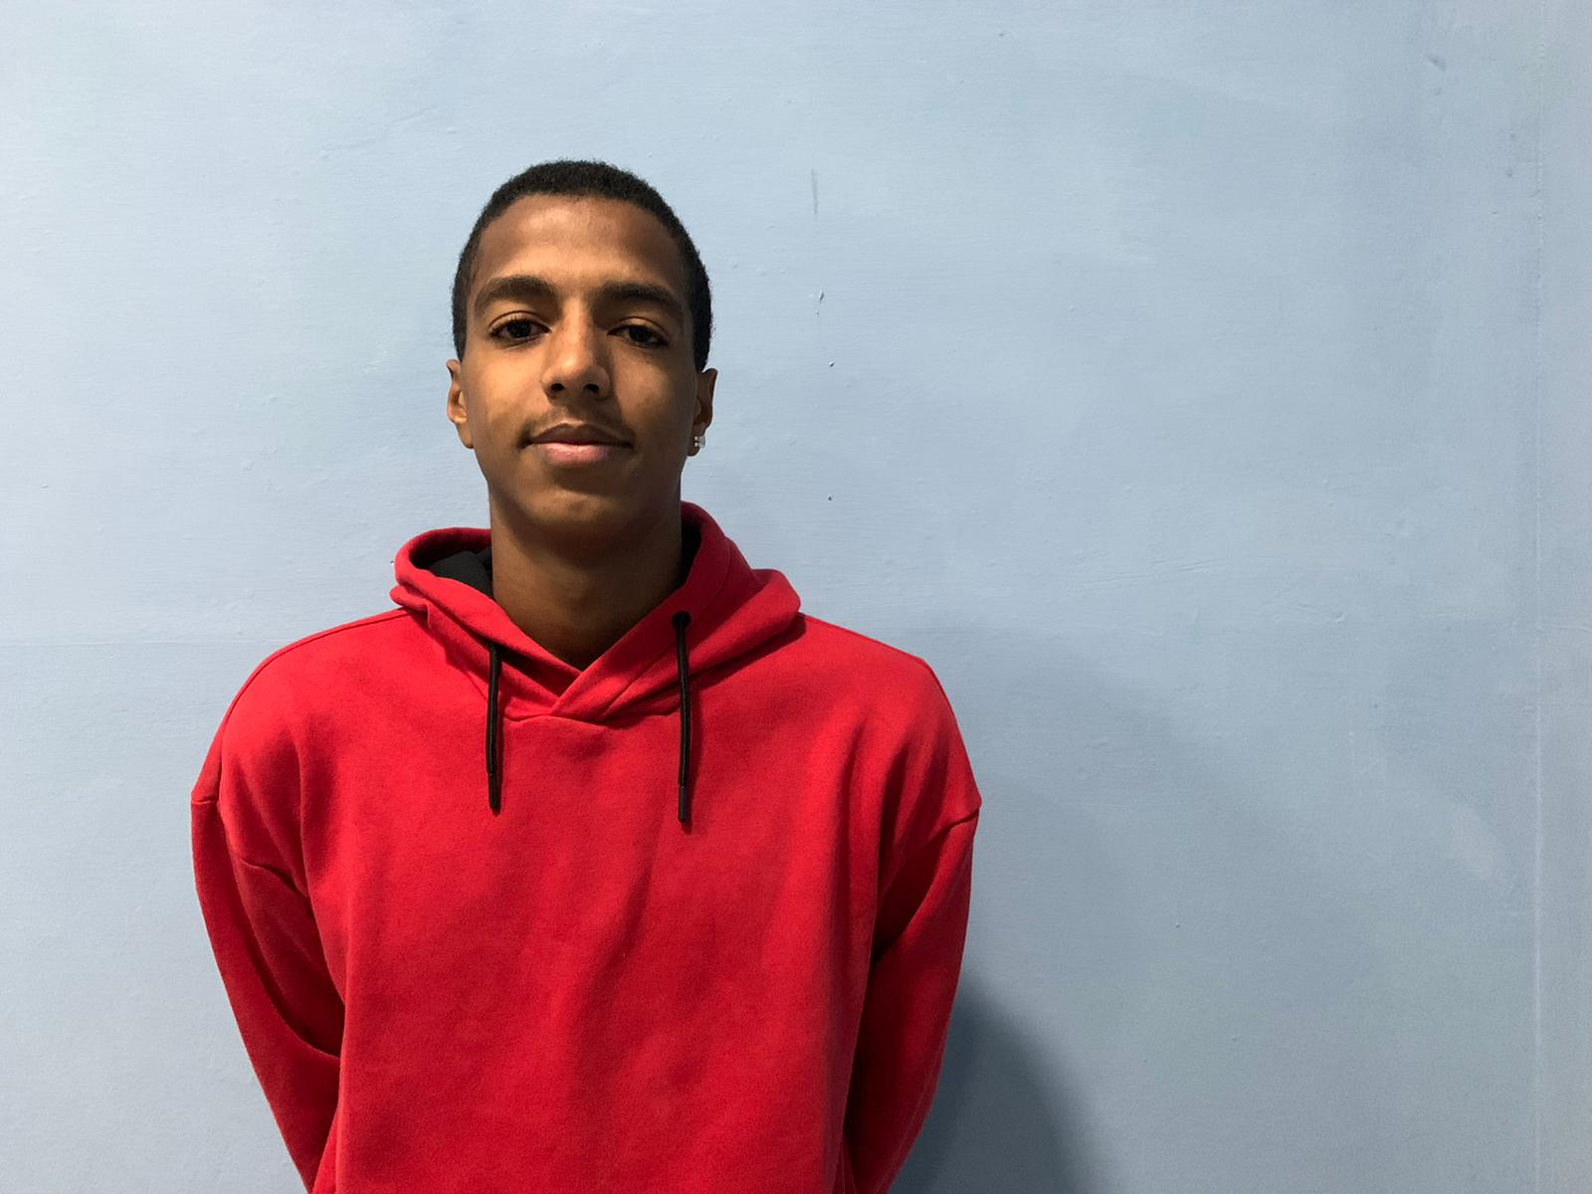
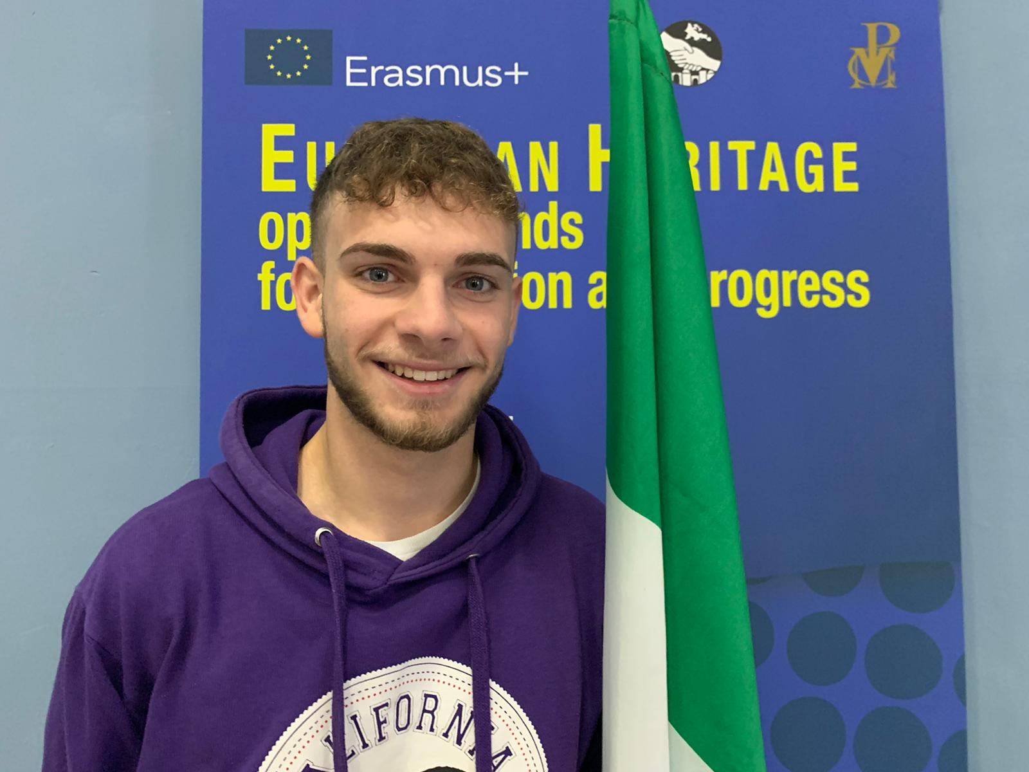
What have we learned?
''We have become more sensitive to the problems of intolerance and also more aware of ways to overcome them.''
''We have learned that each of us can give his/her contribution and accept others for what they are without expressing any judgement.''
''From all this experience we have learned new cultures, new traditions. We have improved our English competence but above all we have really enjoyed staying together and sharing our interests.''

Slide 18
“European Heritage: Opening minds for Integration and progress”
2018-2020
Thank you
for your attention!

